Slide 1
Project Z2
Benedikt Haarscheidt, Prof. Dr. Zoran Nikoloski

Slide 2
Checklist of things we can answer
Does the form/slope of a reaction norm have an effect on the realisation of the plasticity score (are they similar)
Is there an inherent clustering which applies to the scores in terms of their realisations and does this match mathematical properties of the scores
Analysis of trait distribution properties with plasticity score realisation
Correlation
Regression (multiple and single)

Slide 3
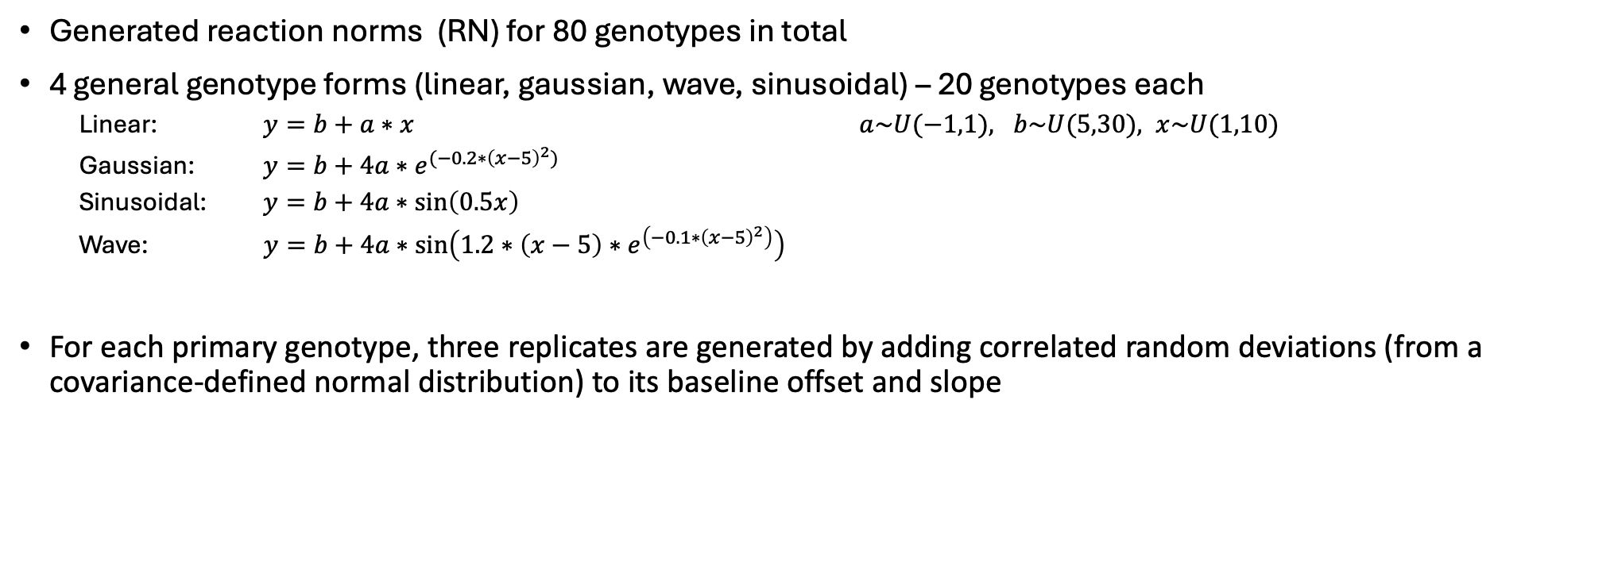
Data Simulation
Generated reaction norms (RN) for 80 genotypes in total
4 general genotype forms (linear, gaussian, wave, sinusoidal) – 20 genotypes each
Linear: $y=b+a∗x$ $a\sim U(−1,1), b\sim U(5,30), x\sim U(1,10)$
Gaussian: $y=b+4a∗e^{{(−0.2∗\left(x−5\right)}^{2})}$
Sinusoidal: $y=b+4a∗\sin\left(0.5x\right)$
Wave: $y=b+4a∗\sin\left(1.2∗\left(x−5\right)∗e^{\left(−0.1∗{\left(x−5\right)}^{2}\right)}\right)$
For each primary genotype, three replicates are generated by adding correlated random deviations (from a covariance-defined normal distribution) to its baseline offset and slope
Notes:
https://besjournals.onlinelibrary.wiley.com/doi/10.1111/j.2041-210X.2011.00160.x

Slide 5
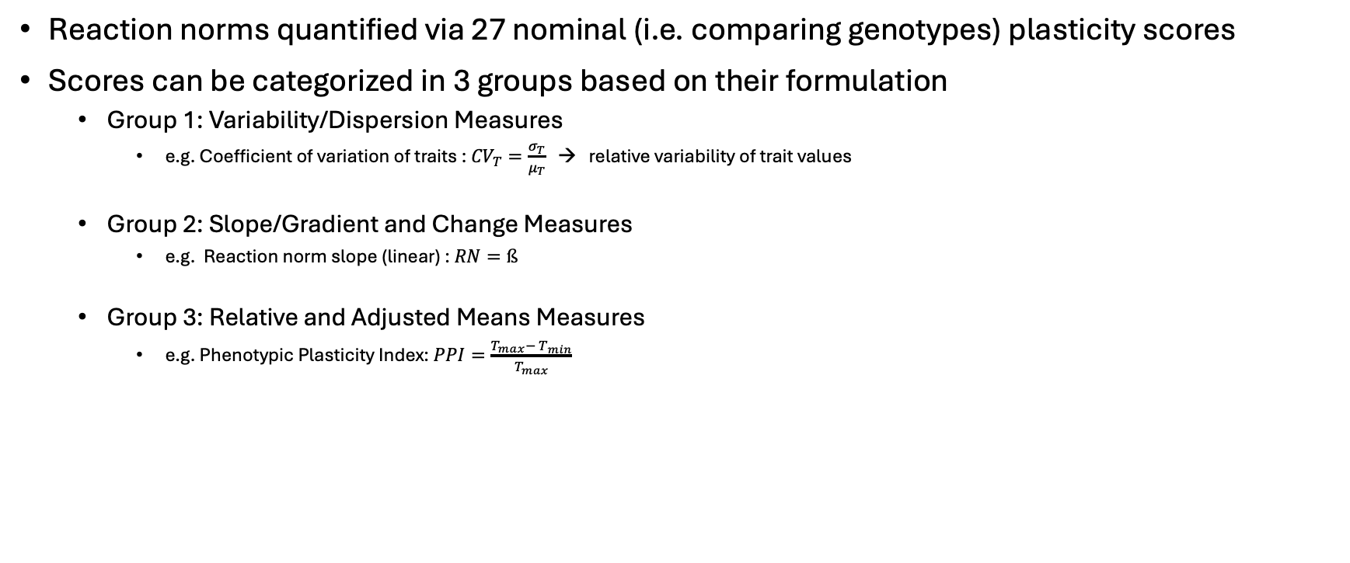
Plasticity scores
Reaction norms quantified via 27 nominal (i.e. comparing genotypes) plasticity scores
Scores can be categorized in 3 groups based on their formulation
Group 1: Variability/Dispersion Measures
e.g. Coefficient of variation of traits : ${CV}_{T}=\frac{σ_{T}}{μ_{T}}$ → relative variability of trait values
Group 2: Slope/Gradient and Change Measures
e.g. Reaction norm slope (linear) : $RN=ß$
Group 3: Relative and Adjusted Means Measures
e.g. Phenotypic Plasticity Index: $PPI=\frac{T_{max}− T_{min}}{T_{max}}$

Slide 6
Do Plasticity Score outcomes for reaction norms (RNs) cluster in line with the groupings?
Adjusted rand index of Hclust results for score realisations of the different genotype forms
 | Linear | Gaussian | Sinusoidal | Wave
Linear | NA | 0.975*** | 0.975*** | 0.927***
Gaussian | 0.975*** | NA | 1.000*** | 0.940***
Sinusoidal | 0.975*** | 1.000*** | NA | 0.940***
Wave | 0.927*** | 0.940*** | 0.940*** | NA
*: p<0.05 **:p<0.01 ***:p<0.001
The clustering of the scores show agreement across the different genotype forms.
However, these clusterings do not reflect the intial grouping.
exemplary clustering results

Slide 7
Are RNs and realisation of plasticity scores similar?
Genotype form | Mantel stat | P-Value
linear | -0.008 | 4.33e-01
gaussian | 0.267 | 1.8e-02
sinusoidal | 0.271 | 2.3e-02
wave | 0.379 | 8e-03
combined | 0.195 | 1e-03
Mantel test results for comparing the RN distance matrix to the plasticity score distance matrix
Heatmap of RN distances (canberra)
Heatmap of plasticity score realisation distances (canberra)
No, they are not!

Slide 8
Does correlation of RNs tell something about the correlation of their realisations of the plasticity scores?
Correlation of pure trait values of RNs
→ Genotype forms are automatically grouped correctly
Correlation of plasticity score realisations for all genotypes
No, apparently not!

Slide 9
Distribution of trait values and plasticity score realisations for RNs
This shows the distribution of the trait values and the plasticity score realisations across all simulated genotypes

Slide 10
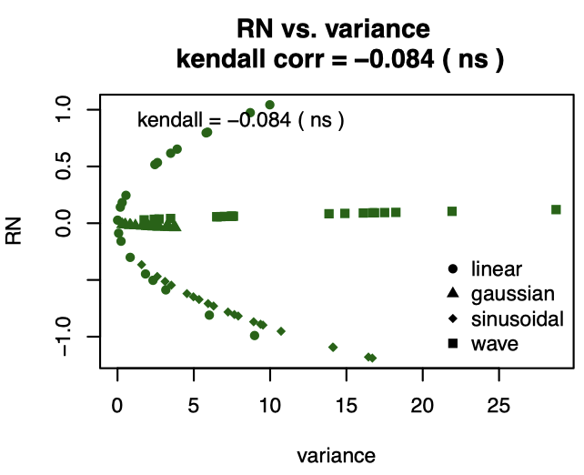
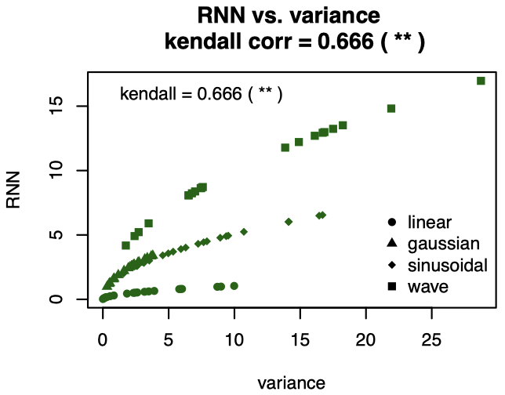
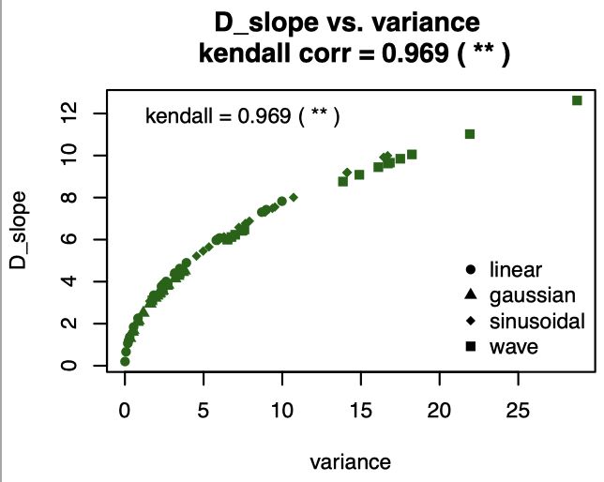
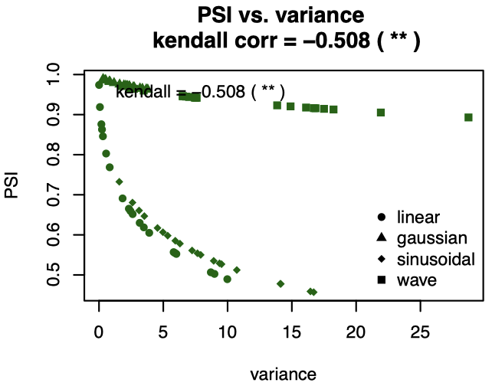
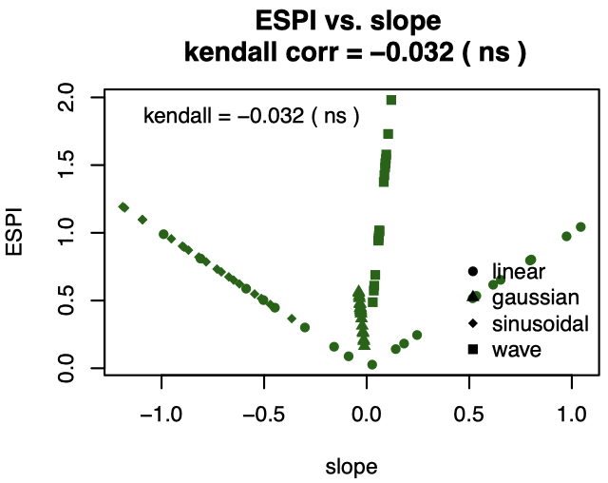
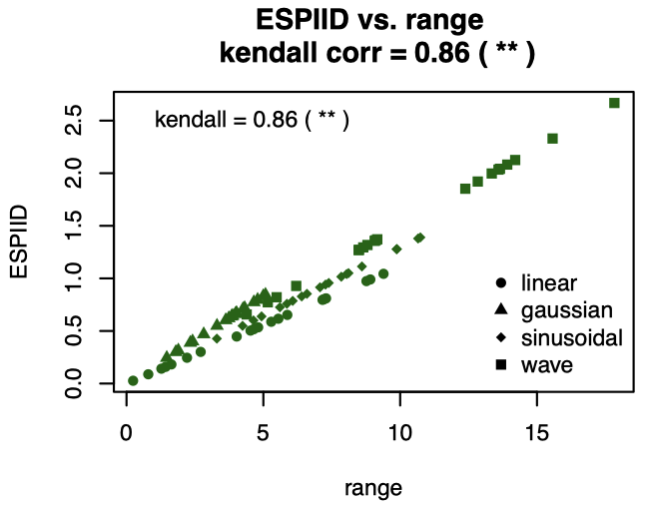
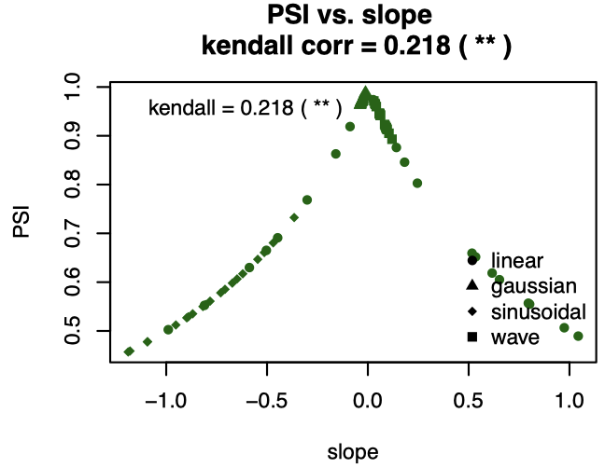
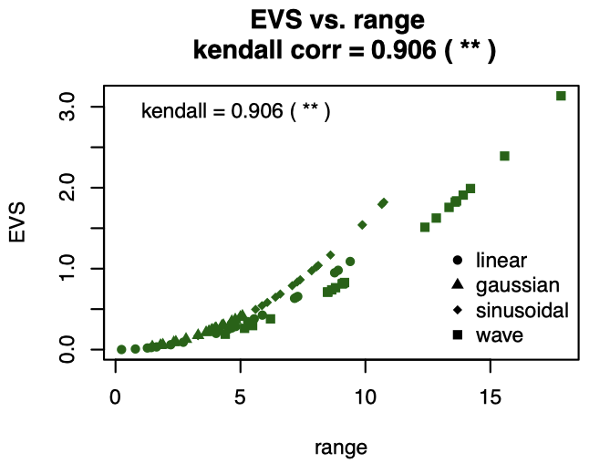
Do the properties of the distribution of a trait correlate with the realisations of the plasticity scores?
*: p<0.05 **:p<0.01 ***:p<0.001
Correlation of the plasticity score realisation for all genotypes with the summary statistics of all genotypes
Even though some of the correlations and their respective p-value appear non significant, the patterns open room for further investigations

Slide 11
Do the properties of the distributions of a trait correlate with the realisations of the plasticity scores?
Columns are the different scores, rows are the different properties of the trait distributions
green cells show the highest absolute correlation per score
yellow cells show the second highest absolute correlation per score
All scores seem to capture the same properties of the trait data (when combined)
Does this change when the different genotype forms are observed separately?
Are correlation values higher for individual genotype forms (and possibly significant)?
→ see next slide

Slide 12
Correlation of summary statistics with plasticity score realisations for different genotype forms displayed in order from top to bottom (linear, gaussian, sinusoidal, wave)

Slide 13
Do the properties of the distributions of a trait correlate with the realisations of the plasticity scores?
When analysed by genotype forms separately the correlation becomes more significant
Almost all plasticity scores correlate with the same summary statistics of the trait best – slope, range, variance
This shows that the plasticity scores indeed capture the aspects of the trait data we want to capture - the plasticity

Slide 14
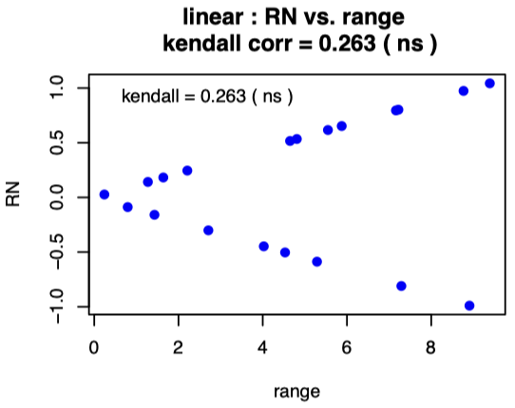
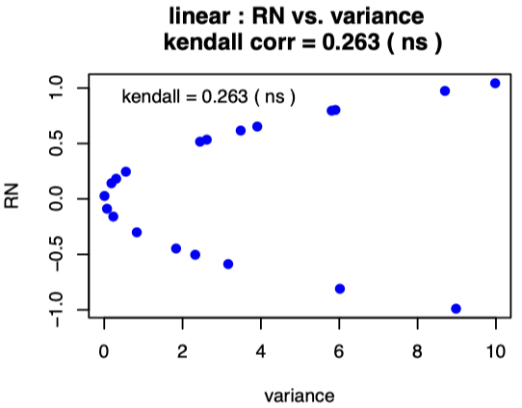
Do the properties of the distributions of a trait correlate with the realisations of the plasticity scores?
When looking at the correlation value of the reaction norm with the range and the variance of the linear data, the value of 0.263 suggests poor correlation
HOWEVER:
Even in some cases when the pure corrlation value for an individual genotype form suggests poor and non-significant correlation, there sometimes is some non-linear relation between the respective summary statistic and the realisation of the score!

Slide 15
Is there a single best score for capturing the summary statistics of the trait data?
Some of the scores show better and some worse correlation with the summary statistics.
Which ones show the highest average, significant correlation across all summary statistics? (all non significant correlation values are ignored)

Slide 16
Is there a single best score for capturing the summary statistics of the trait data?
Which ones show the highest average correlation across the variance, the slope and the range (all other summary statistics are ignored)?

Slide 17
Do outliers affect this correlation?
Data is modified so that one of the 10 measurements per reaction norm is extreme
3 scenarios:
only positively modified (scaled by random number between 1 and 2)
only negatively modified (scaled by random number between 0 and 1)
both (scaled by random number between 0 and 2)
with outliers

Slide 18
Positive outliers
The correlation of PQ, PR, ESPI and NRW with the range and variance remains robust in the case of positive outliers

Slide 19
Negative outliers
The correlation of PQ, PR, ESPI and NRW with the range and variance remains robust in the case of negative outliers.

Slide 20
Both outliers
The correlation of PQ, PR, ESPI and NRW with the range and variance remains robust in the case of outliers in both directions

Slide 21
Do outliers affect this correlation?
The results on the previous slides indicate that some of the plasticity scores are sensitive to outliers in a sense that their correlation with specific summary statistics of the trait data is affected
Also the correlation with the slope is lower than in scenarios with no outliers (across all forms of outliers) and mostly non significant
However they also indicate that some of the scores are more robust to outliers than others, hinting superiority (even under conditions where the outliers are more extreme(not shown here))

Slide 22
Does resolution of the reaction norm affect this correlation?
I.e. will more or less measurements per genotype affect the correlation?
The computation of some scores is more complex and a higher resolution can eventually lead to computational infeasibility (e.g. PPF)
The RNN is not computable for too little measurements (n<3) as it is the sum of all n-degree polynomial coefficients

Slide 23
Does resolution of the reaction norm affect this correlation?
Lower resolution – 5 trait values across the range of environments (1-10)
Again, the correlation with the slope is lower than for a higher resolution (10 measurements) and mostly non significant

Slide 24
Lower resolution 5

Slide 25
Does resolution of the reaction norm affect this correlation?
Lower resolution – 2 trait values across the range of environments (1-10)

Slide 26
Effect of sampling resolution on correlation with summary statistics
From the previous plots, it becomes evident that some scores exhibit more pronounced shifts in their correlation coefficients (across different summary statistics) when the sampling resolution changes, while others remain relatively stable. One can infere robustness from this
These observations can help infer each score’s robustness.
The following slides illustrate how the correlations for a selected set of scores vary under different sampling resolutions
Note: only significant correlation values (p<0.05) are displayed and therefor the curves might not be continuous over the full range

Slide 27
Effect of sampling resolution on correlation with summary statistics

Slide 28
Effect of sampling resolution on correlation with summary statistics

Slide 29
Effect of sampling resolution on correlation with summary statistics
It becomes evident that the range and the variance of the reaction norms correlate significantly with the ESPI, D-Slope, NRW, PR, PQ and EVS – disregarding the resolution of the norm
How effectively can these summary statistics be used to model—or predict—the observed scores through regression?

Slide 30
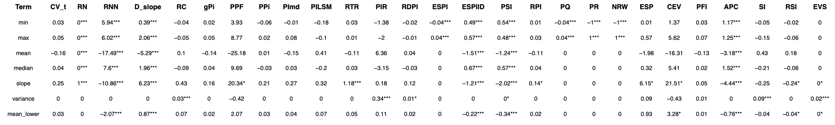
Summary statistic regression per score
Full model with all summary stats as predictors (combined)
Range and mean_upper show collinearity with other predictors and therefor are not considered in OLS
*: p<0.05 **:p<0.01 ***:p<0.001

Slide 31
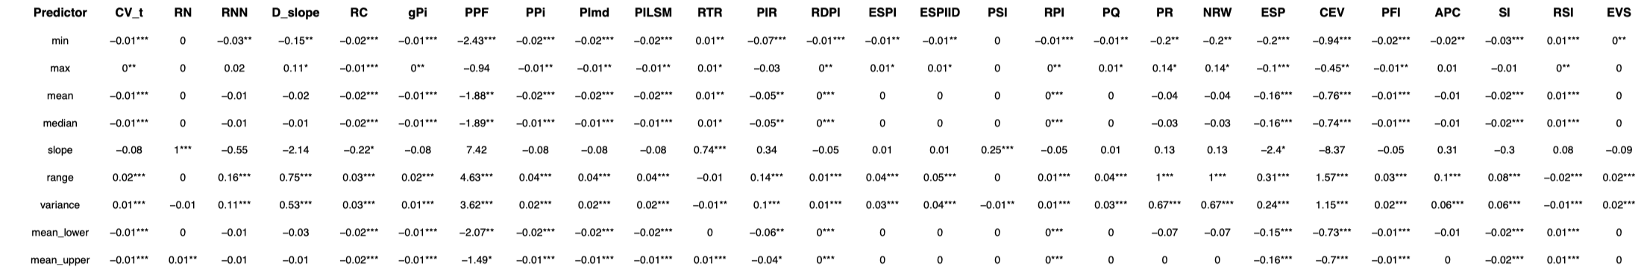
Summary statistic regression per score - individually
simple models for each summary stat separately (only one predictor)
Coefficient of regression in table
*: p<0.05 **:p<0.01 ***:p<0.001

Slide 32
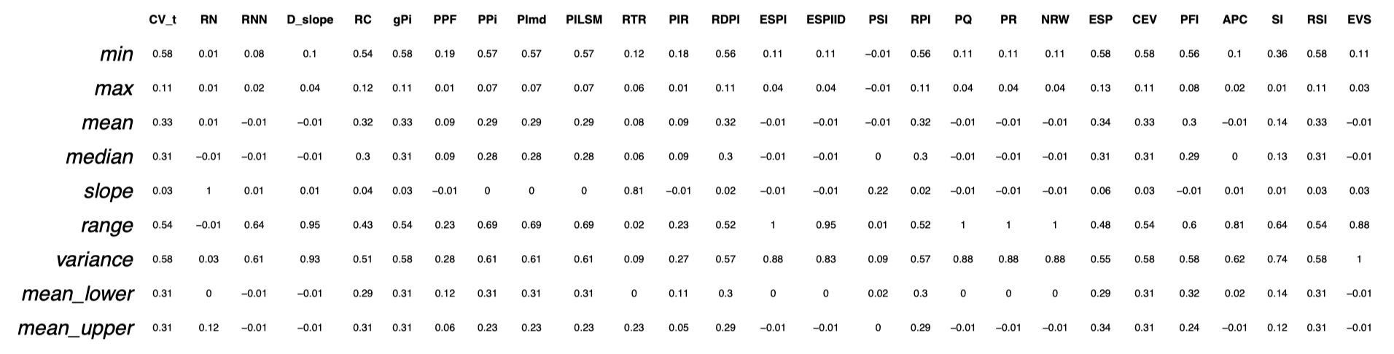
R2 for single predictor models

Slide 33
Average R2 for single predictor models

Slide 34
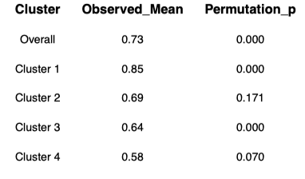
Clustering of scores based on R2

Slide 35
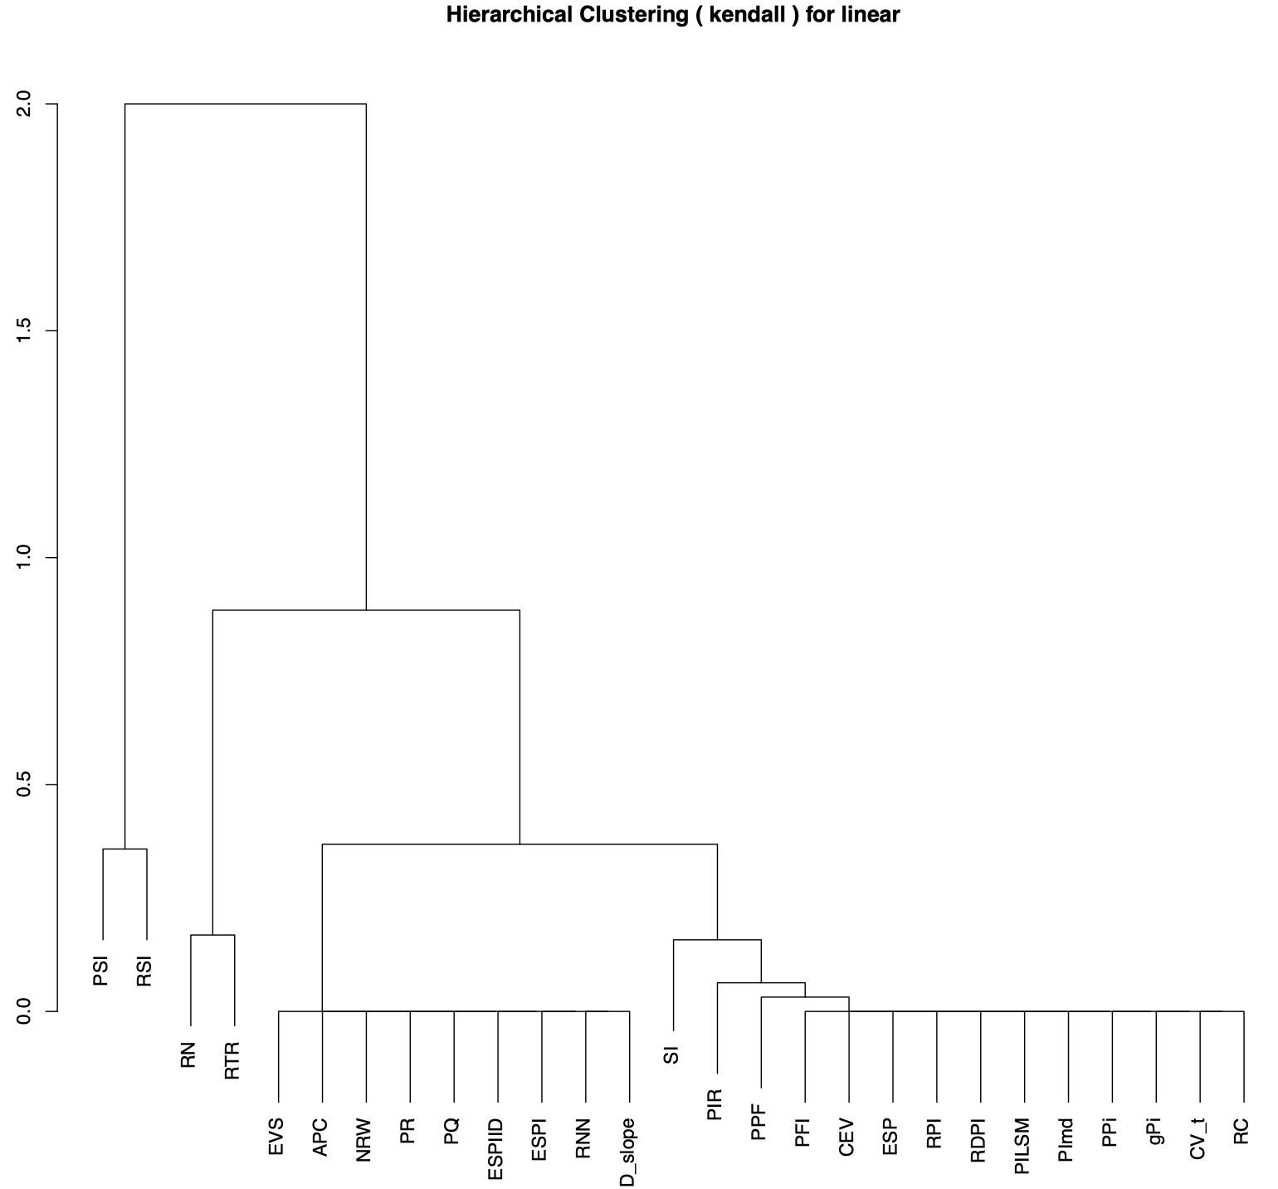
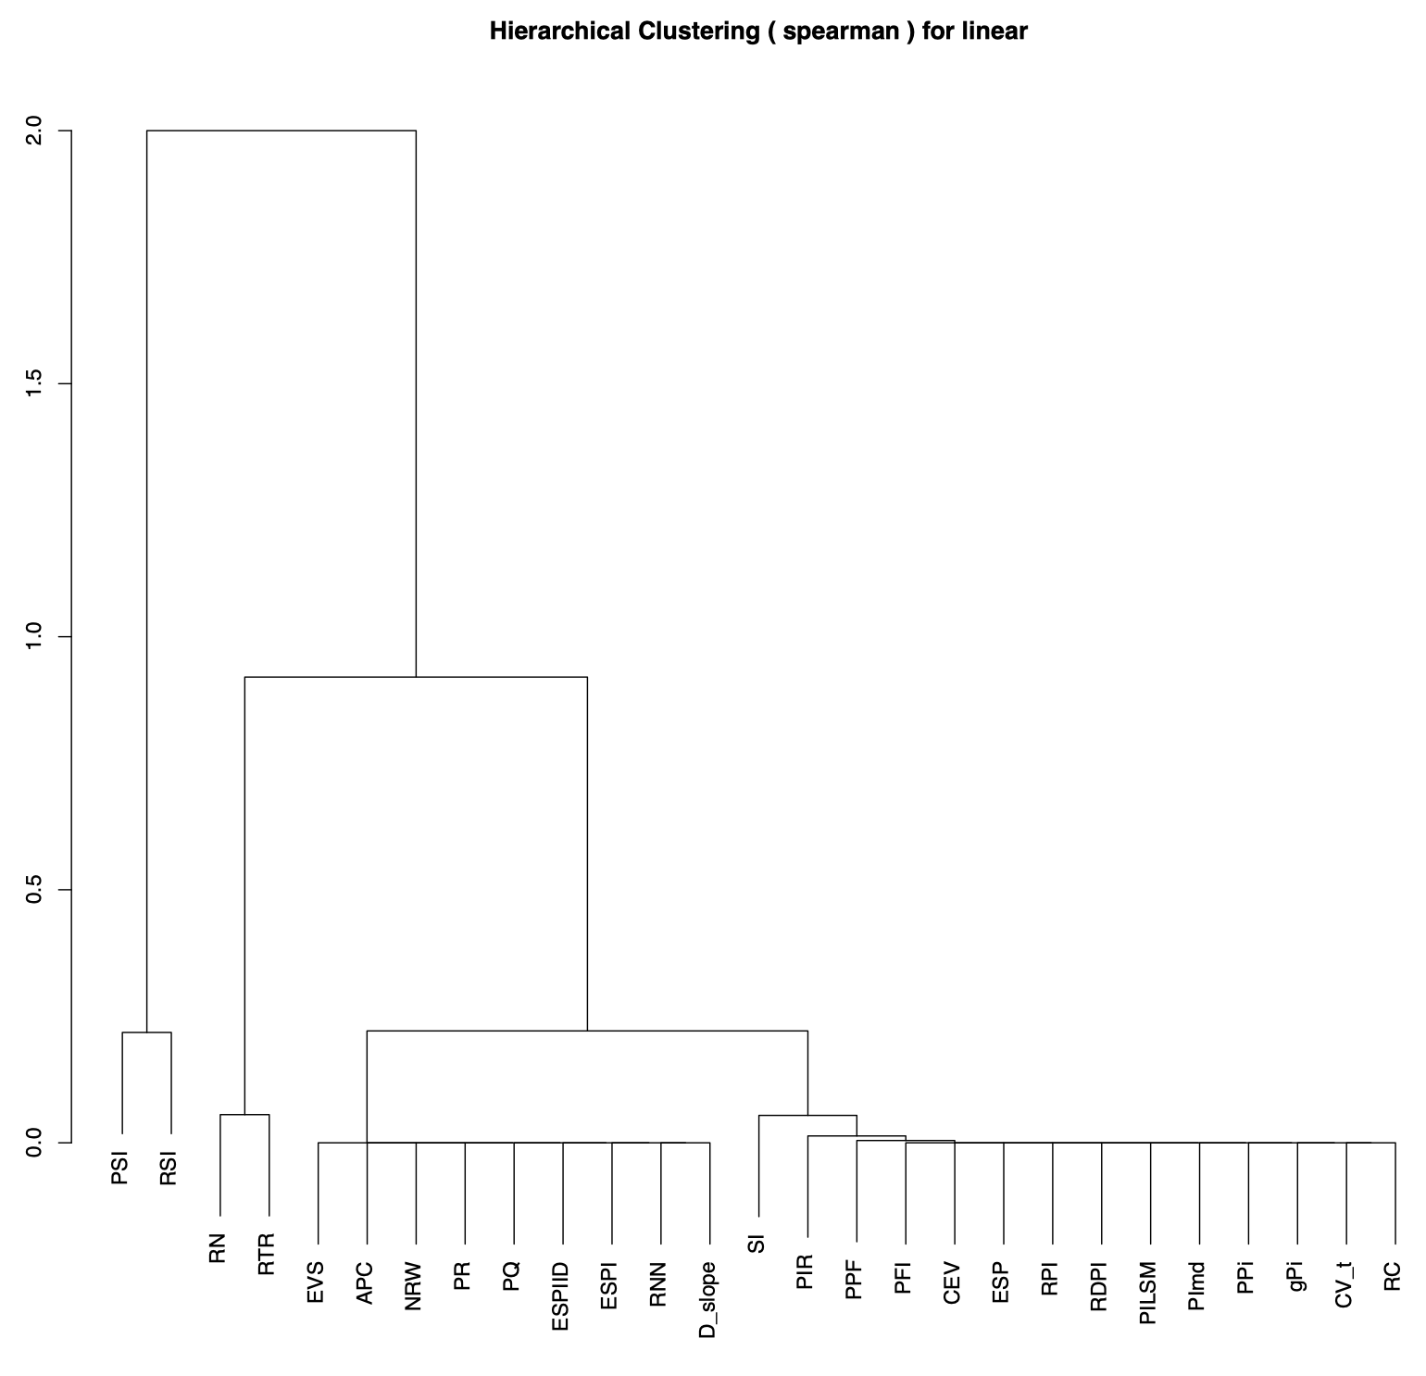
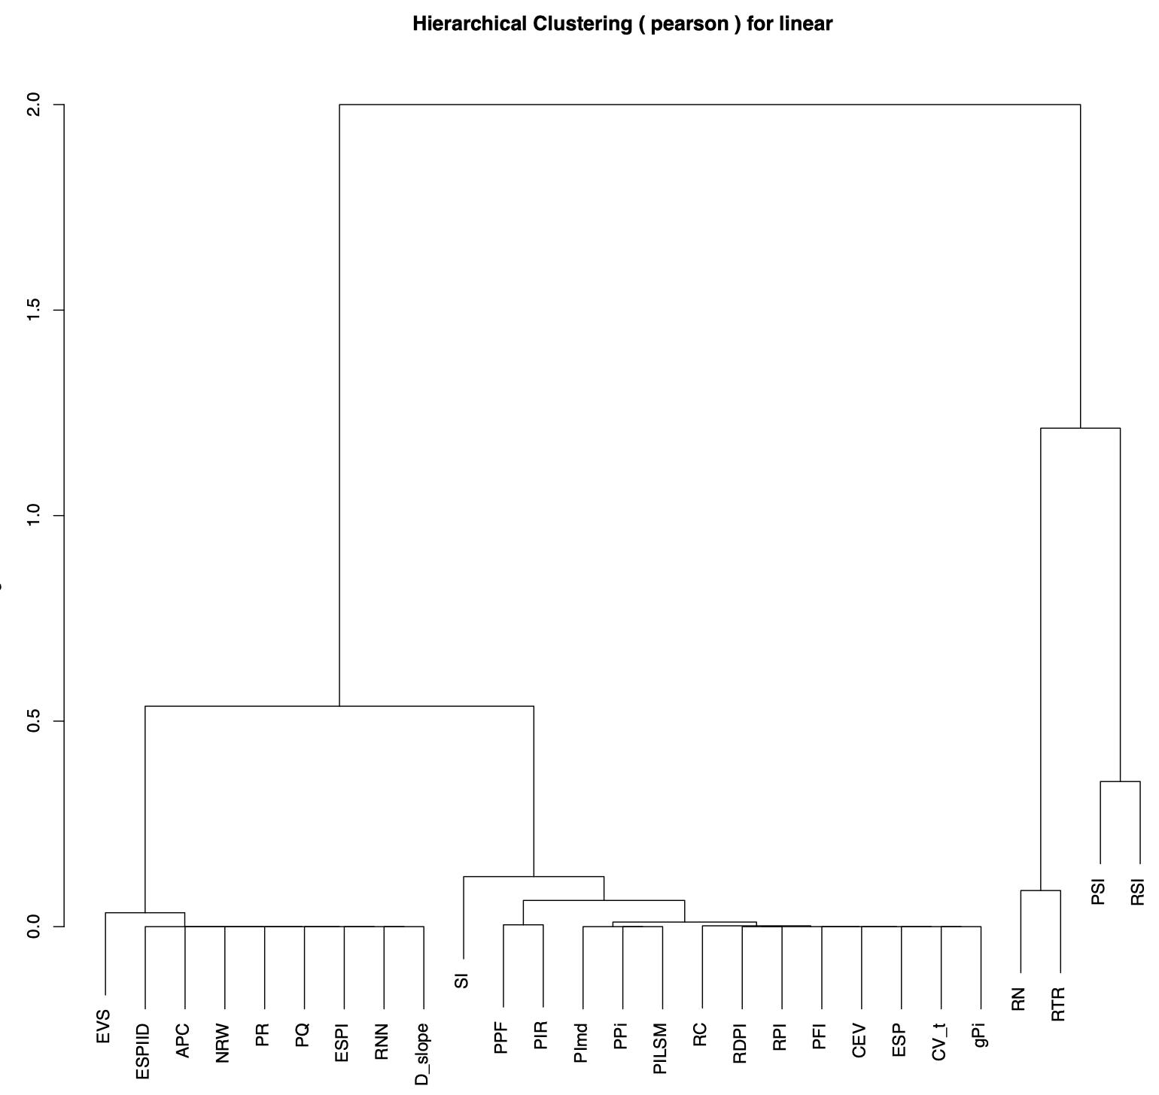
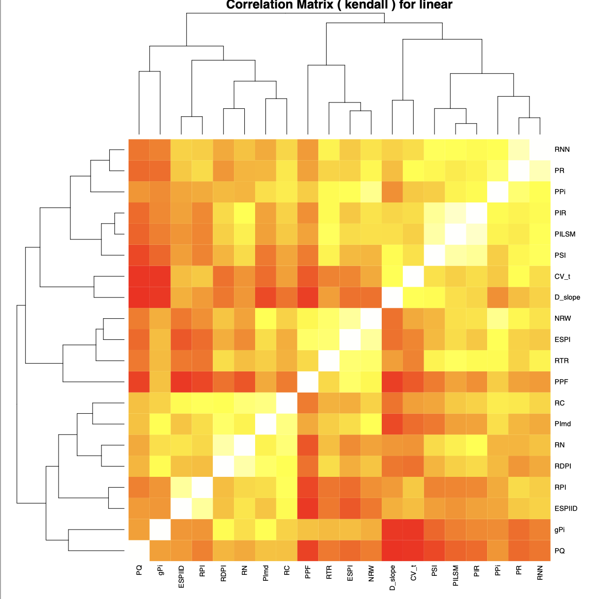
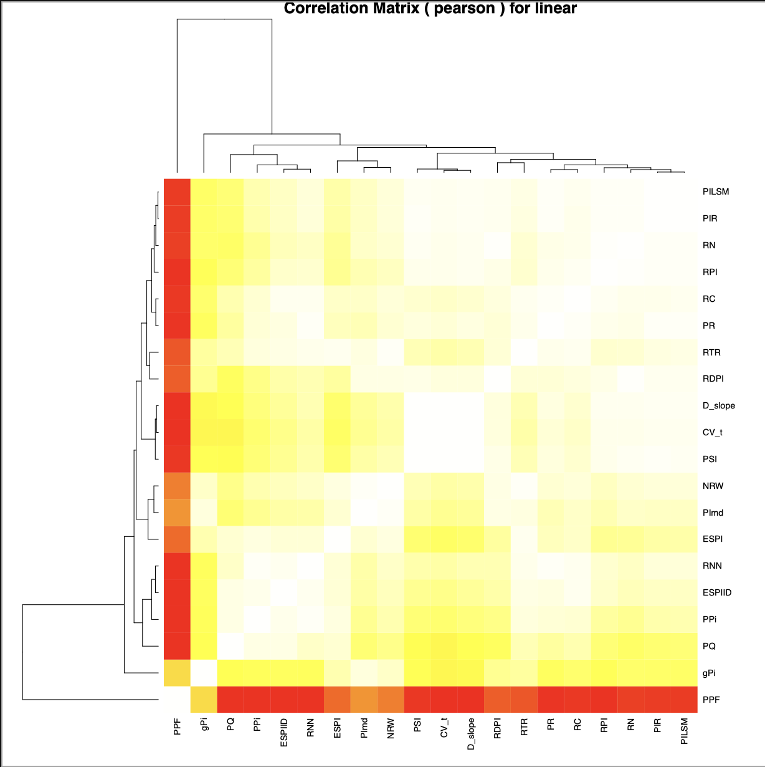
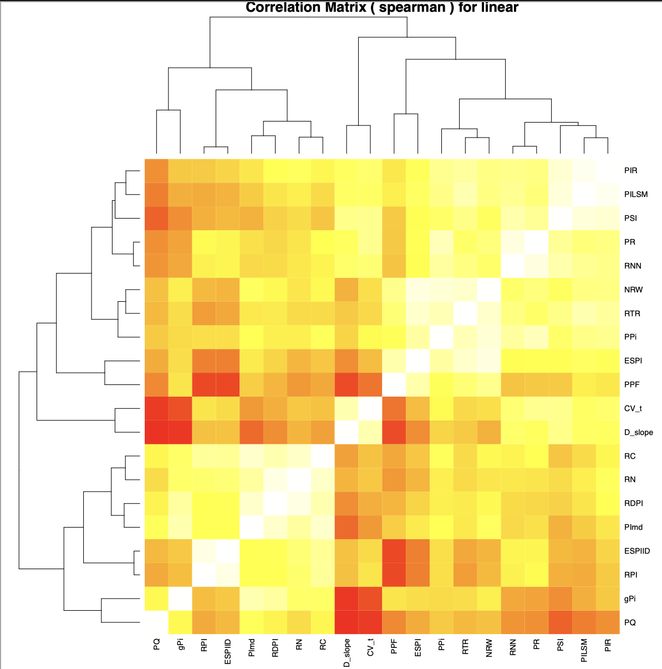
Clustering of correlation of scores for linear reaction norms – kendall and spearman show agreement → kendall for ordinal associations might be the best, no?

Slide 36
Clustering of correlation of scores for different reaction norm types→ kendall for ordinal associations might be the best, no? best number of clusters is 4 (based on avg silhouette width)

Slide 37
Clustering of all genotype forms combined. 2 clusters as per best silhouette score.

Slide 38
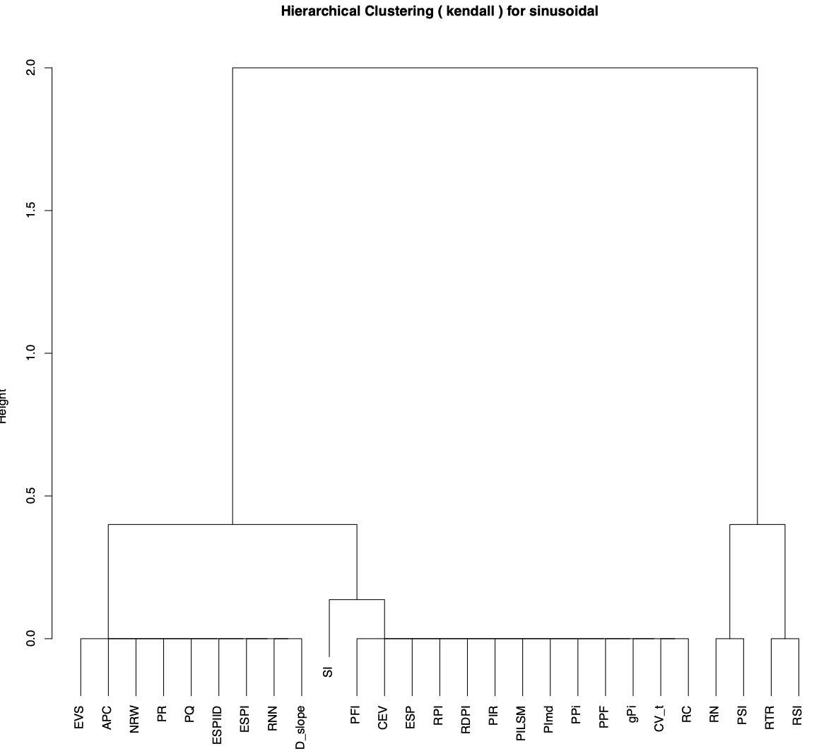
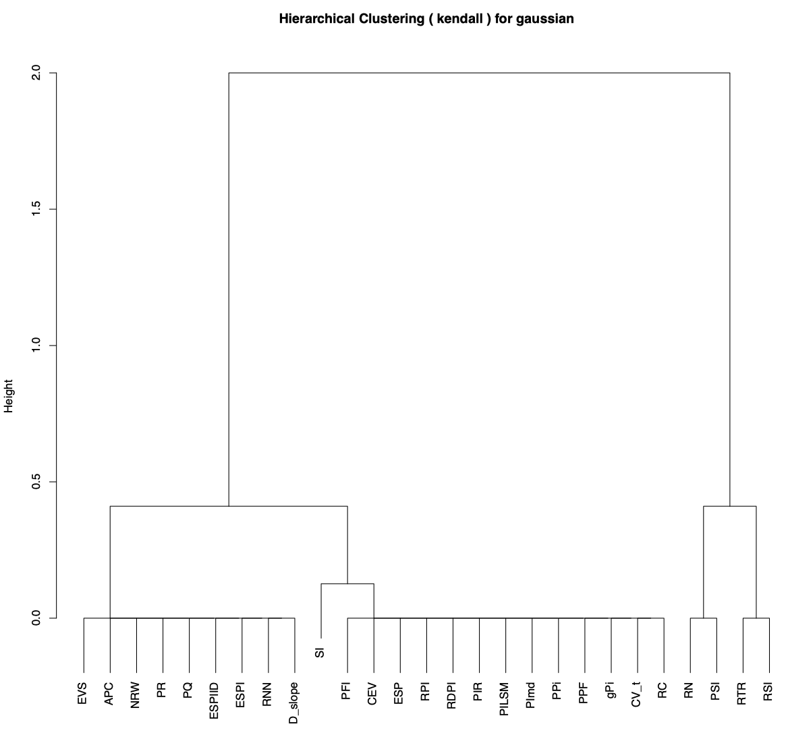
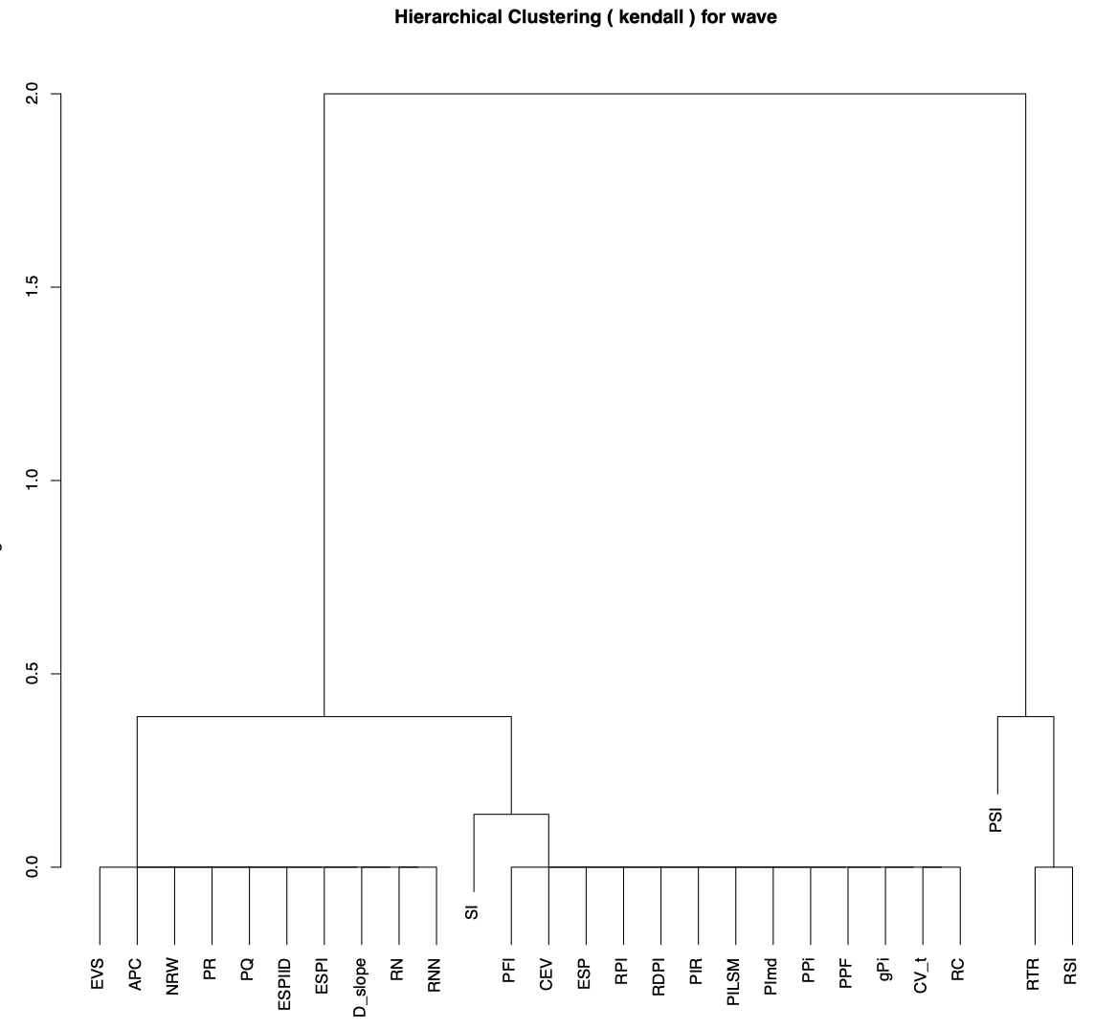
Hclust of correlation of scores from reaction norms – kendall, separated genotype forms

Slide 39
Hclust of correlation of scores from separate reaction norm forms – kendall – no. clusters = 4

Slide 40
Hclust of correlation of scores from combined reaction norm forms – kendall – no. clusters = 2

Slide 41
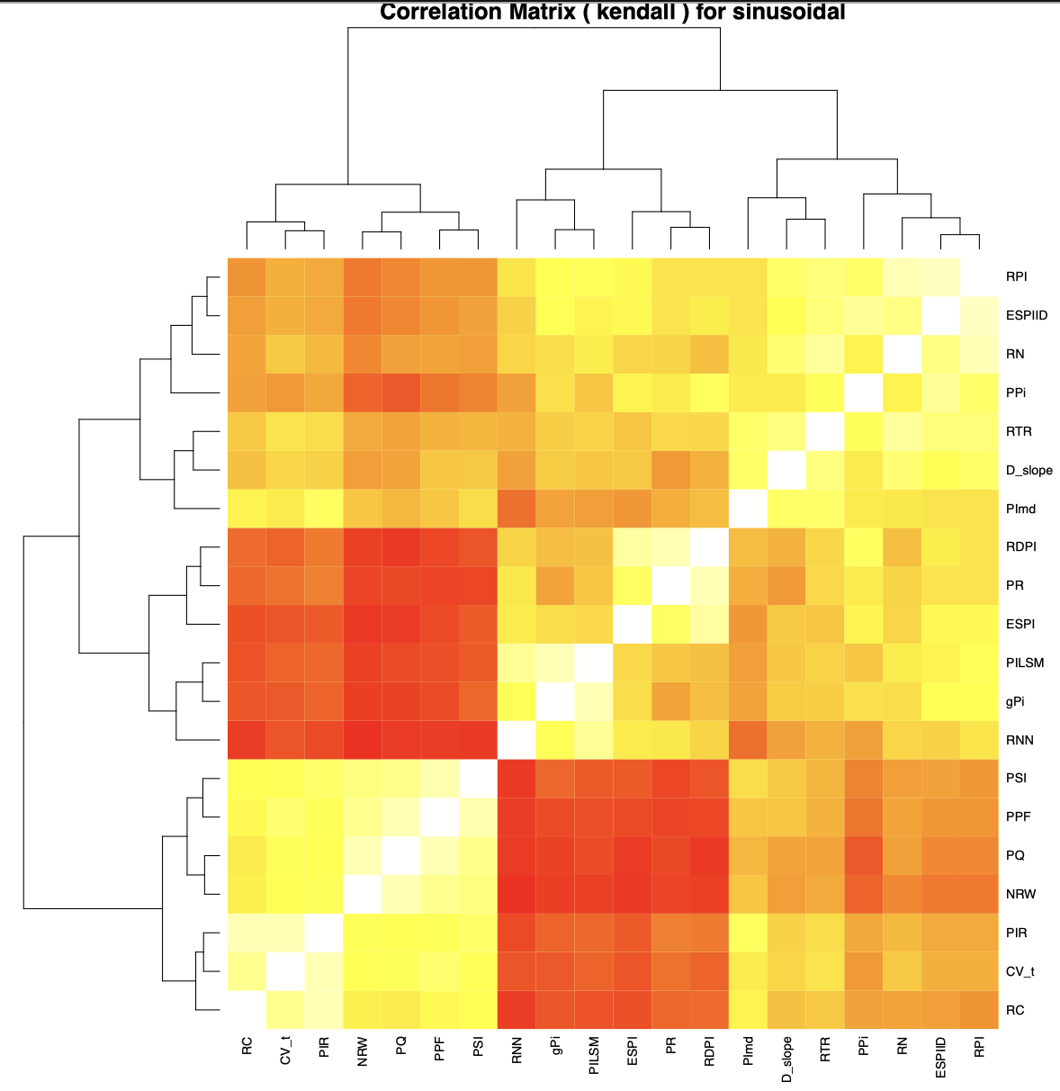
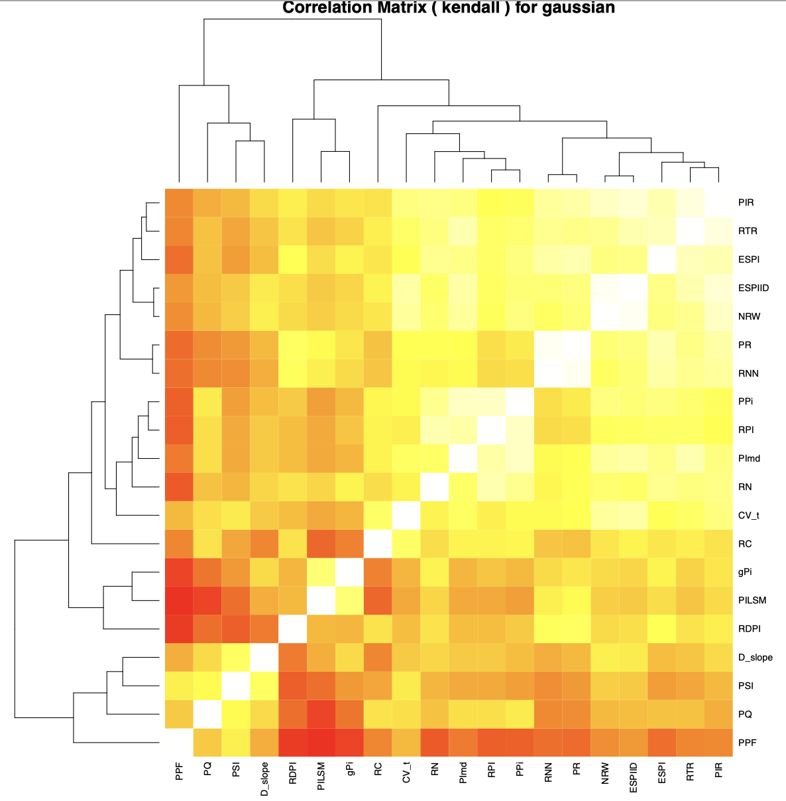
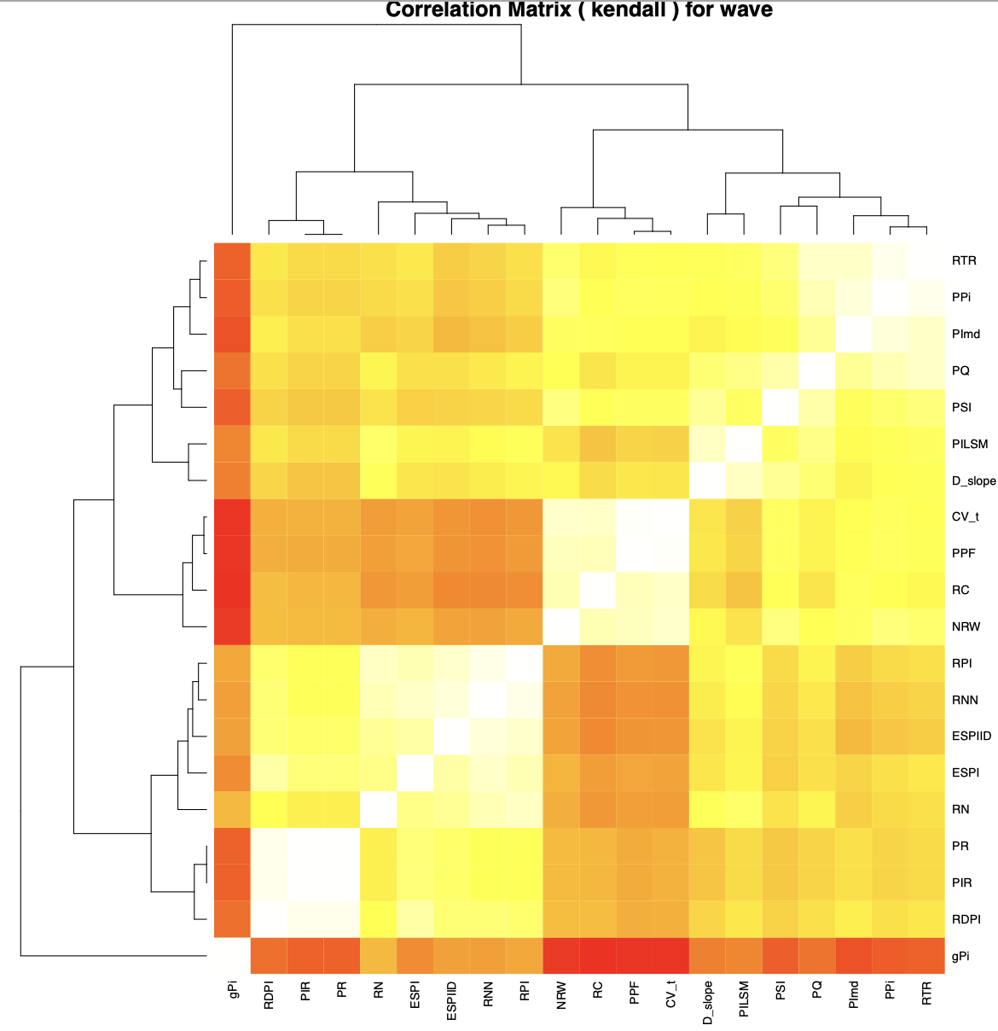
Heatmaps of correlation of scores from reaction norms – kendall, separated genotype forms

Slide 42
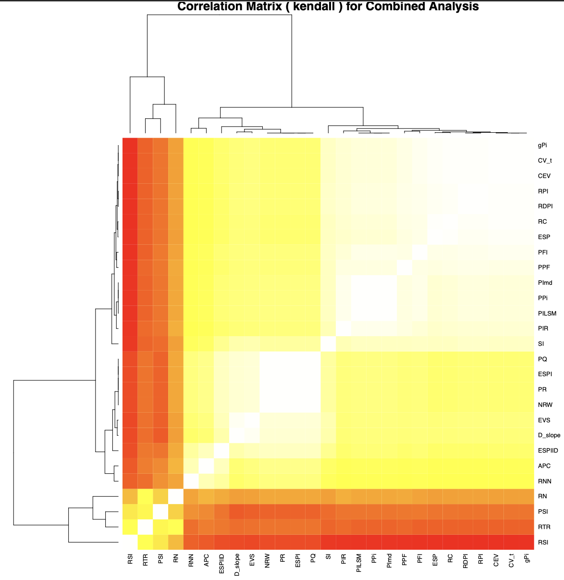
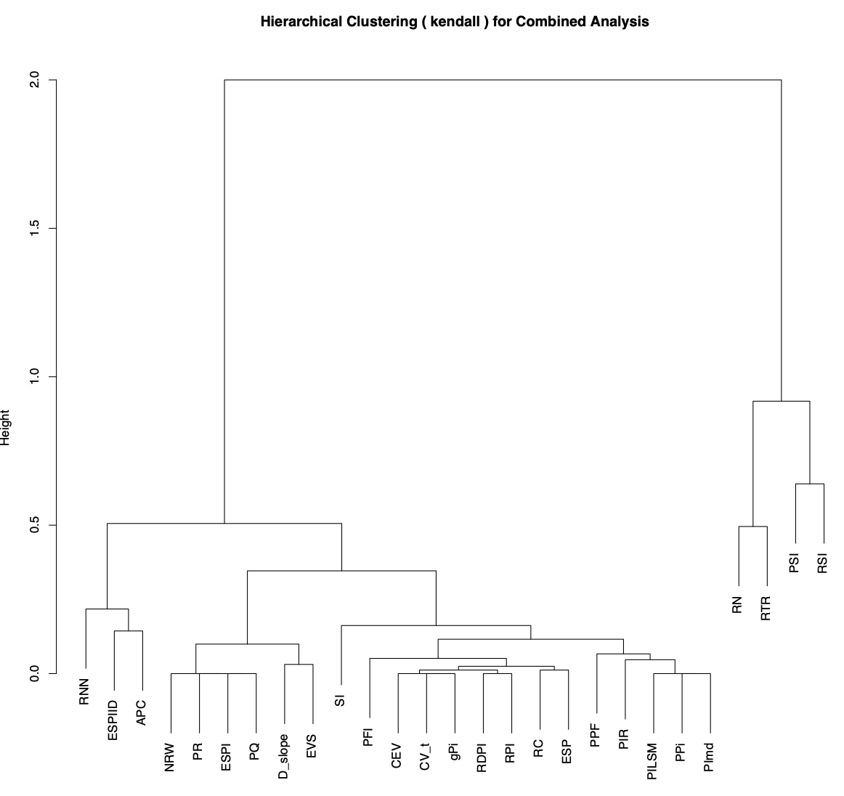
Clustering of correlation of scores from reaction norms – kendall, combined genotype forms

Slide 43
Clustering based on coocurrence in clusters as computed previously

Slide 44
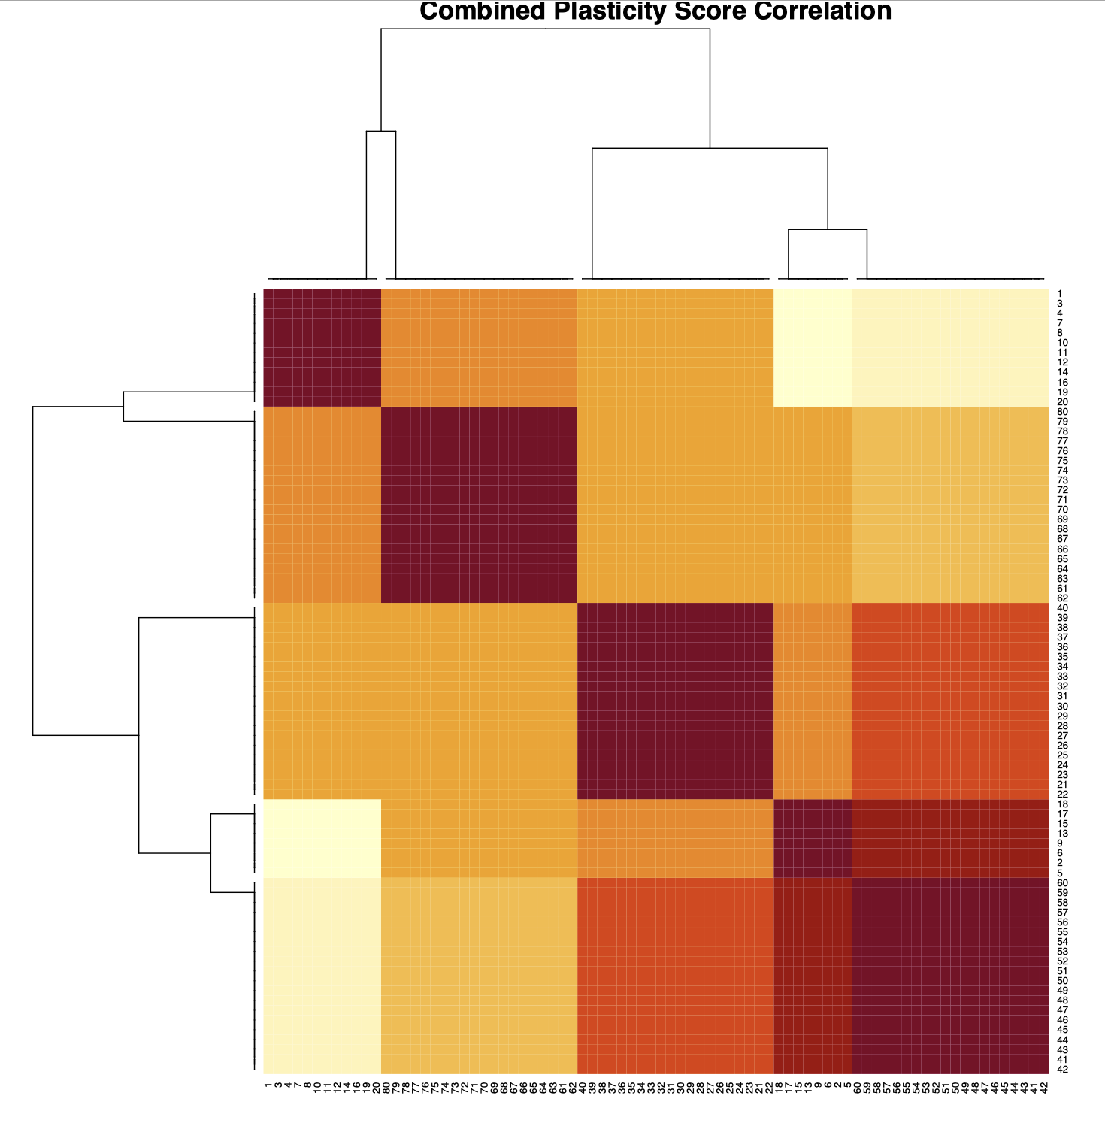
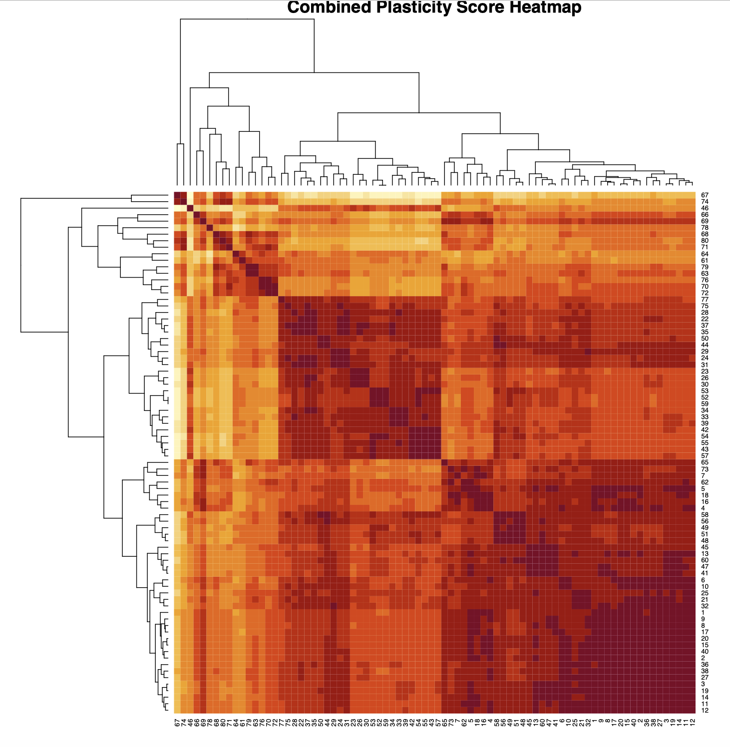
Correlation of RNs vs correlation of plasticity score realisations for genotypes → there is no direct, straigforward mapping from one space to the other

Slide 45
Distribution of trait values and scores

Slide 46
Correlation (pearson, kendal, spearman, dcor, cosine similarity) of summary statistics (mean,min,max,median, slope, range, variance) with realisation of individual plasticity scores
Separated by reaction norm form (linear, gaussian,…)
All reaction norm forms combined
Note that these are examples and there are 600+ plots for that

Slide 47
Correlation (pearson) of summary statistics (mean,min,max,median, slope, range, variance) with realisation of individual plasticity scores
Linear
Gaussian
Sinusoidal
Wave
Global (all forms combined)

Slide 48
Correlation (spearman) of summary statistics (mean,min,max,median, slope, range, variance) with realisation of individual plasticity scores
Linear
Gaussian
Sinusoidal
Wave
Global (all forms combined)

Slide 49
Correlation (kendall) of summary statistics (mean,min,max,median, slope, range, variance) with realisation of individual plasticity scores
Linear
Gaussian
Sinusoidal
Wave
Global (all forms combined)

Slide 50
Correlation (dcor) of summary statistics (mean,min,max,median, slope, range, variance) with realisation of individual plasticity scores
Linear
Gaussian
Sinusoidal
Wave
Global (all forms combined)

Slide 51
Correlation (cosine) of summary statistics (mean,min,max,median, slope, range, variance) with realisation of individual plasticity scores
Global (all forms combined)
Linear
Gaussian
Sinusoidal
Wave

Slide 52
Clustering of genotypes in regards to summary statistics (min,max,mean,median, range, slope, variance, lower mean, upper mean)
Separated by reaction norm form (linear, gaussian,…)
All reaction norm forms combined
Note that these are examples and these plots exist for each genotype form separate and combined

Slide 53
Cluster assignments of genotypes in regards to summary statistics (min,max,mean,median, range, slope, variance, lower mean, upper mean)

Slide 54
Clustering of genotypes in regards to plasticity scores
Separated by reaction norm form (linear, gaussian,…)
All reaction norm forms combined
Note that these are examples and these plots exist for each genotype form separate and combined

Slide 55
Cluster assignments of genotypes in regards to plasticity scores

Slide 56
Cluster assignments of genotypes in regards to plasticity scores

